Slide 1
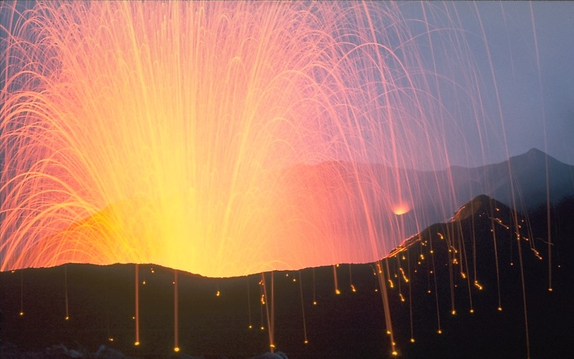
Notes:
No this is not Hawaii, but I wanted to get your attention with perhaps the most beautiful eruption photo I’ve ever seen! This is actually Stromboli in Italy. It erupts basaltic lava like the Hawaiian volcanoes, …

Slide 2
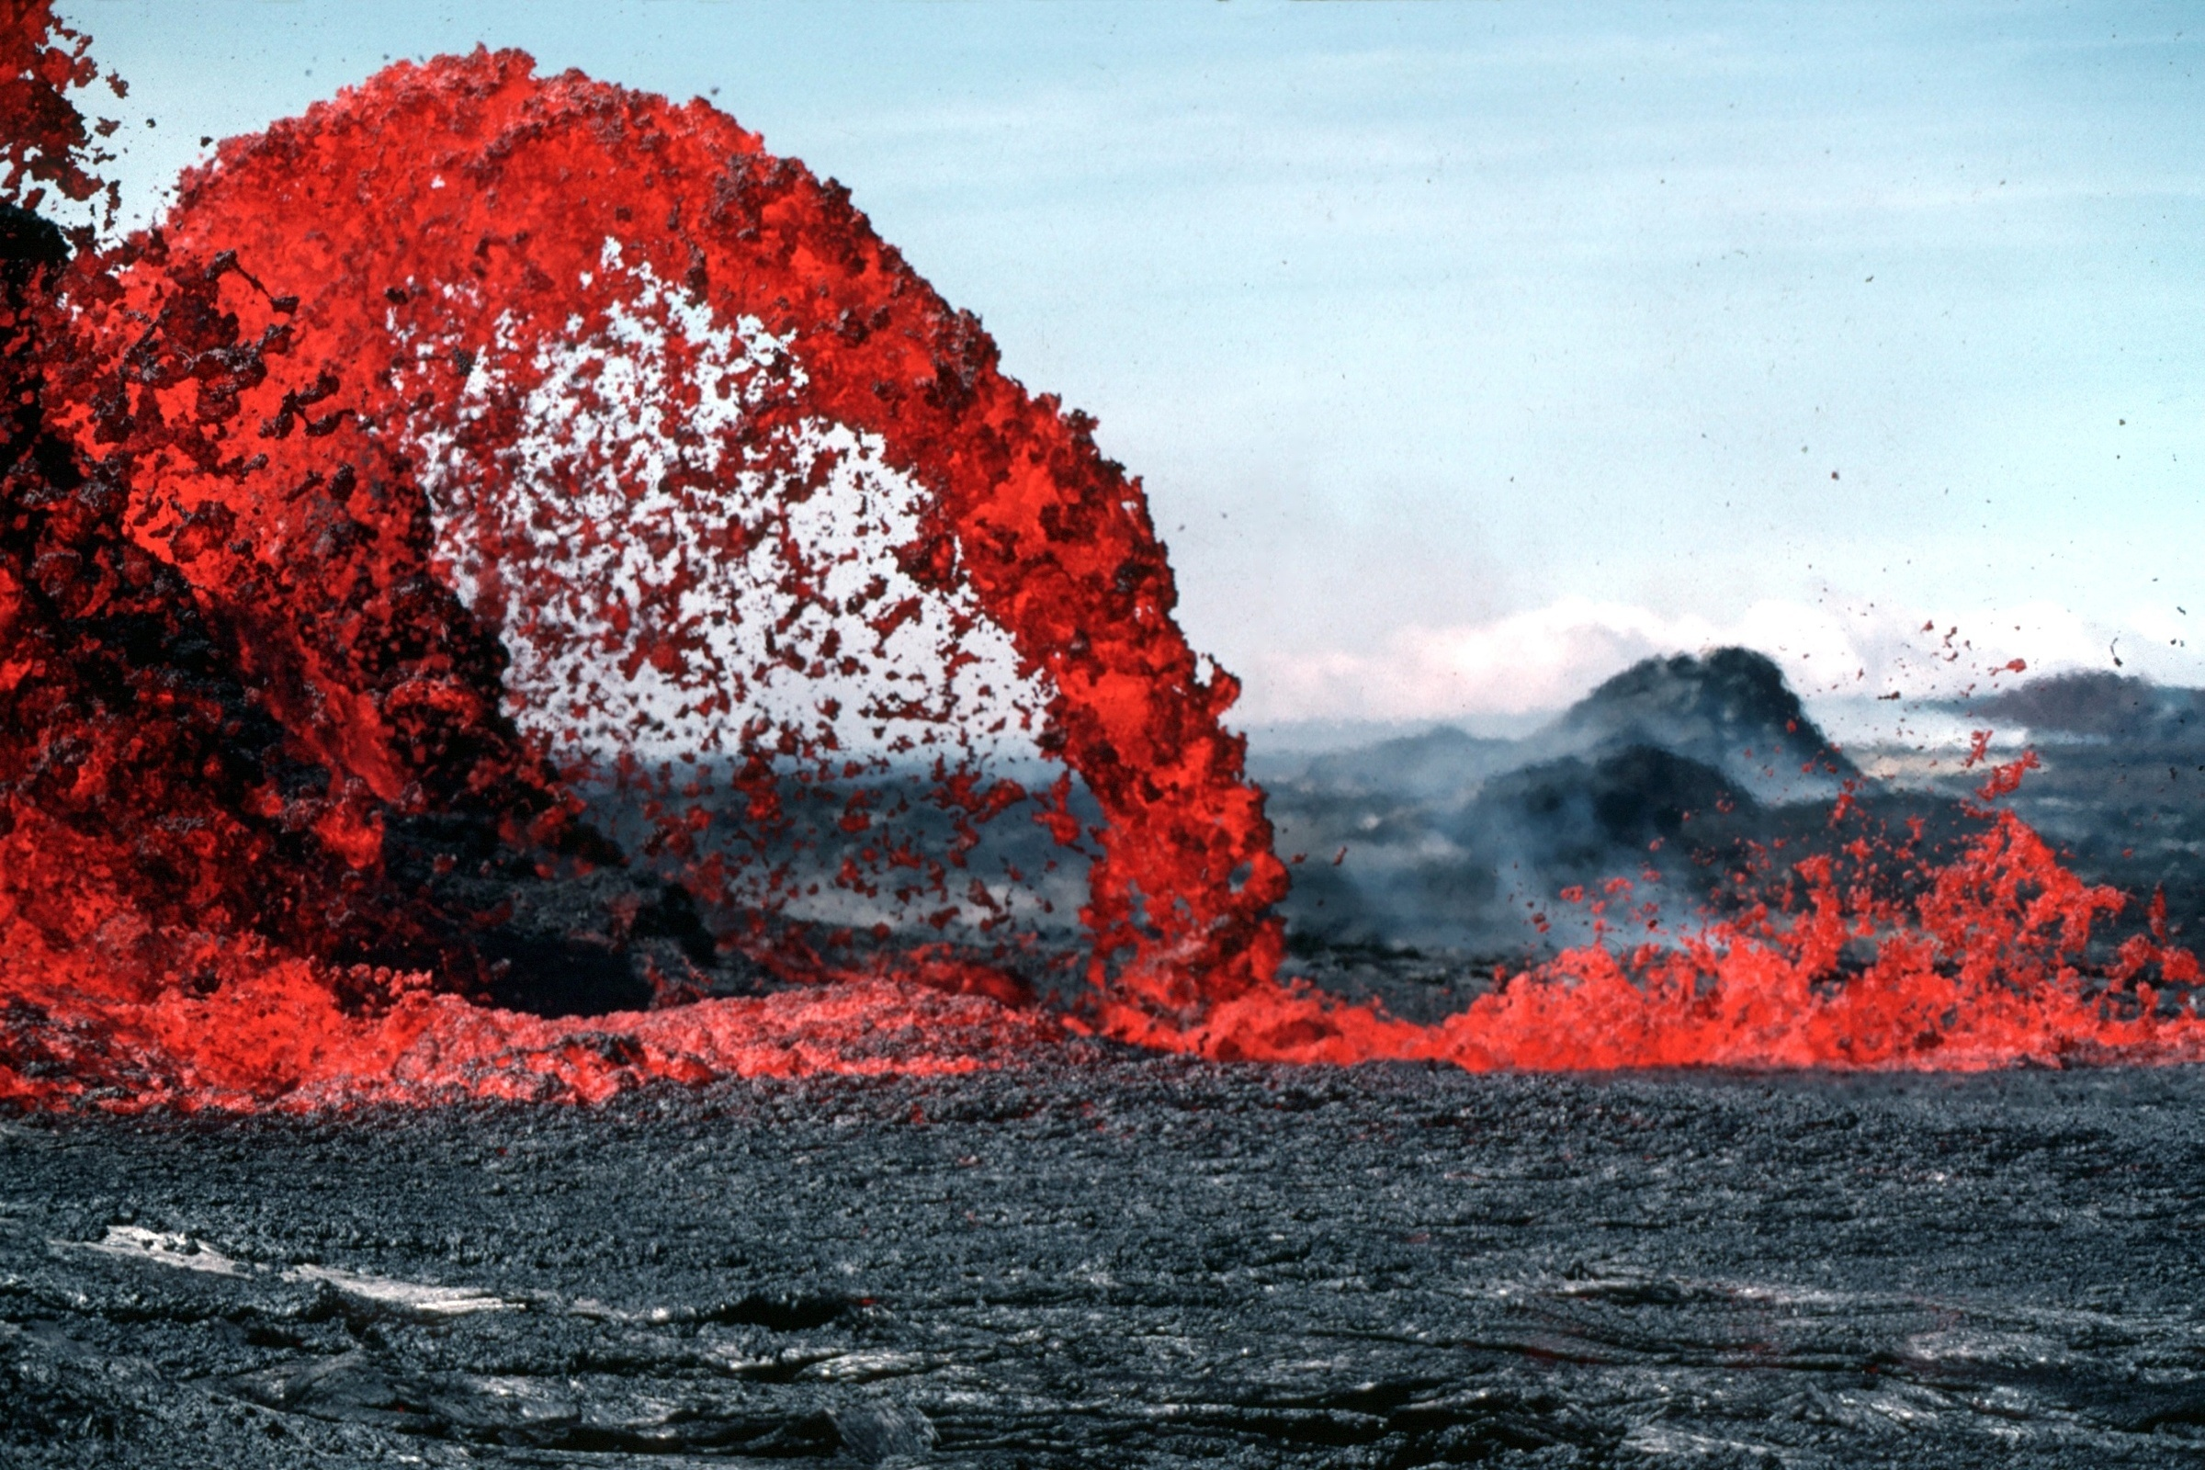
Notes:
… but the Hawaiian volcanoes have a much different eruptive style ….

Slide 3
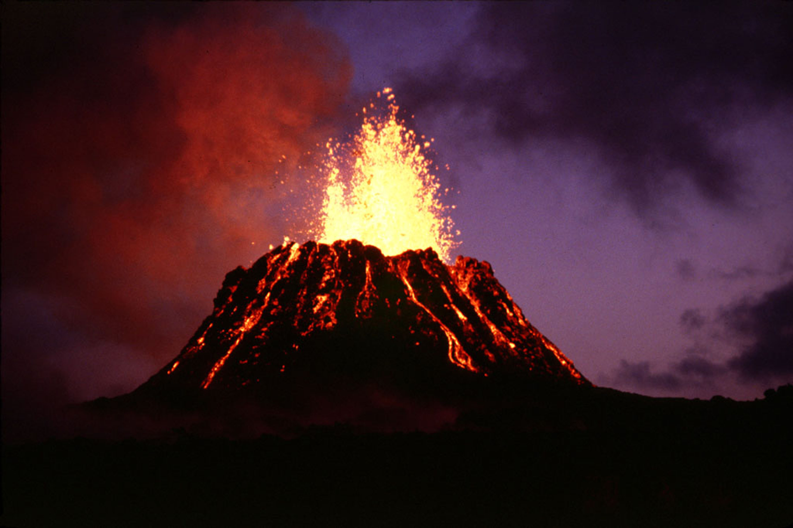
Notes:
… characterized by lava fountains and flows …

Slide 4
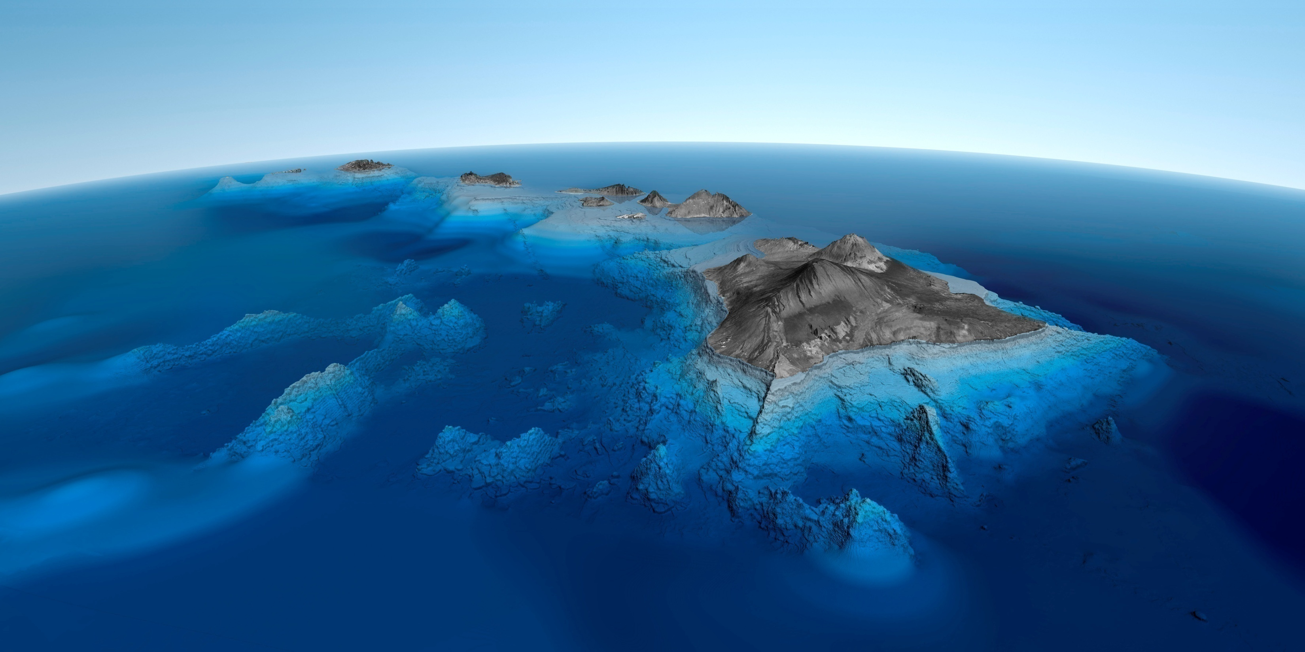
HOT SPOT
Notes:
… because the Hawaiian volcanoes are were formed at a hot spot whereas Stromboli is associated with a subduction zone. In this lesson we will first look at modern hot spot theory, …

Slide 5
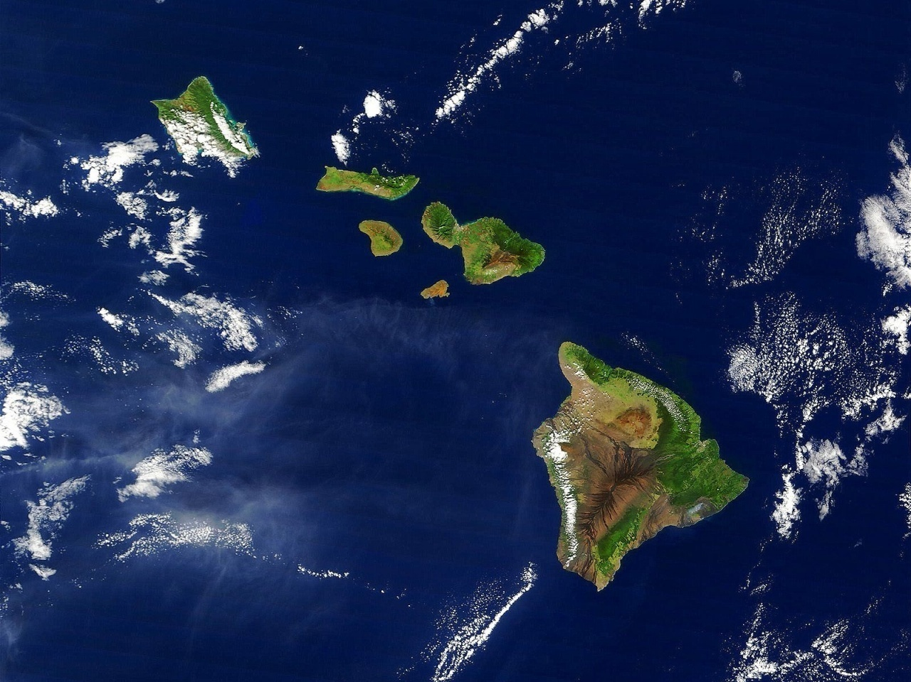
Lesson Overview
Hot Spot Theory
Shield Volcanoes
Generalized Eruption
Volcanic Features
Chaos Theory
Notes:
…then examine the general characteristics and evolution of shield volcanoes - contrasting Maui’s Haleakala National Park with the Big Island’s Hawaiian Volcanoes National Park. We will also present a model for a typical shield eruption and learn about the surprisingly diverse array of volcanic features produced from lava that is uniformly basaltic. We will end the lesson (and the class) with an introduction to Chaos Theory, which I think provides a useful paradigm by which to understand how tremendous complexity can arise when simple rules (such as those that apply to lava flows) are applied iteratively.

Slide 6
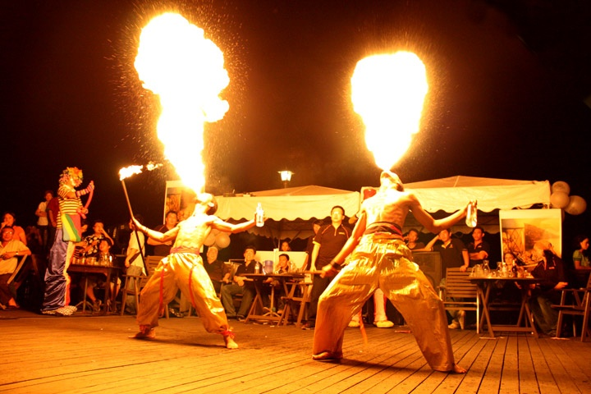
Hot Spot
Theory
Notes:
First up: What exactly are these things geologists call hot spots?

Slide 7
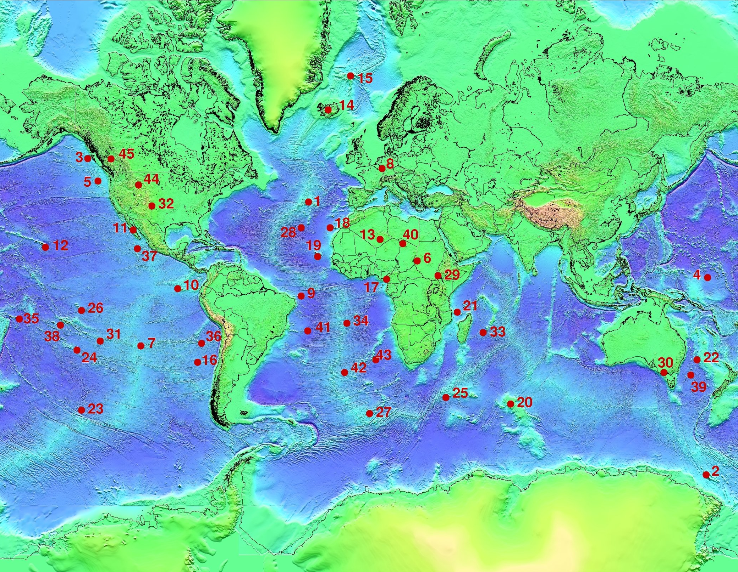
Notes:
A hotspot is a location on the Earth's surface that has experienced active volcanism for a long period of time, but not as a result of plate subduction or spreading. There are several dozen currently active hot spots scattered more or less randomly across the surface of the earth.

Slide 8
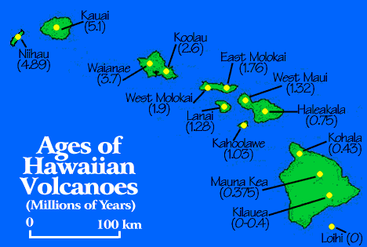
Notes:
They are commonly associated with fairly linear chains of volcanoes showing a pattern of decreasing ages away from the hot spot.

Slide 9
Notes:
J. Tuzo Wilson (founder of the Wilson cycle) attributed the pattern …

Slide 10
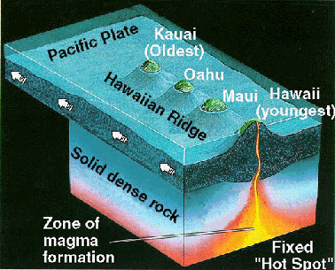
Notes:
… to the existence of a hot mantle plume beneath the lithosphere, which continuously brings new magma to the surface.

Slide 11
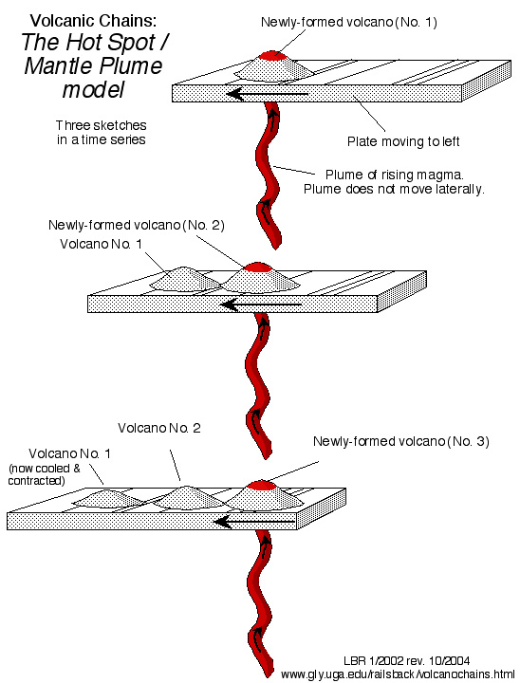
Notes:
As proposed by Wilson, hot spots had fixed positions relative to other hot spots, but the plates moved over them. Volcanoes grow on the portion of the plate directly above the hot spot, but since the volcanoes are attached to the moving plates, they eventually move away from the hot spot and become extinct while new volcanoes form over a fresh part of the plate that is moved into position above the hot spot. Eventually a string of volcanoes is produced that grows older away from the hot spot. This explanation was generally accepted by scientists for decades and Hawaii literally became the “textbook example” of an island chain formed by a stationary mantle plume.

Slide 12
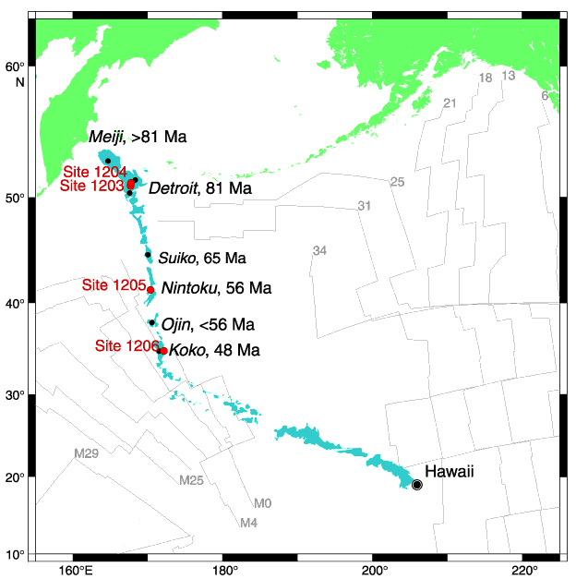
Notes:
However, as the textbook example, the Hawaiian-Emperor Seamount chain received a lot of scientific attention, which gradually uncovered numerous aspects of the Emperor and Hawaiian chains unpredicted by the plume hypothesis. I’ll not go into all of these, but let me point out one that I think is makes it especially clear that the hot spot has not been stationary. Samples were taken from the Emperor Seamounts from which paleomagnetic data was retrieved. Had the hot spot remained stationary, then all of the specimens would have been magnetized at a latitude equal to the present hot spot location at Hawaii. While that was true of samples taken from seamounts along the Hawaiian Ridge, the paleomagnetic data collected from the Emperor Seamounts indicated they were magnetized significantly further north of Hawaii.

Slide 13
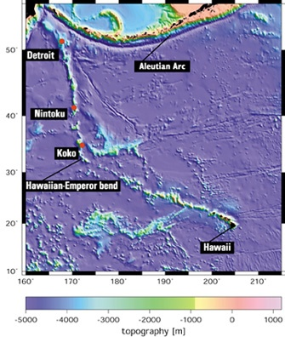
“The big conclusion from our Leg is that the Hawaiian hotspot was moving south at a fairly high velocity in the period of Emperor Seamount production about 80 to 45 million years ago Then the hotspot stopped moving and plate motion took over, creating the Hawaiian-Emperor bend.”
Notes:
So apparently the Hawaiian hotspot was moving south during the period of Emperor seamount formation about 80-45 million years ago. Then the hotspot stopped moving and plate motion took over, creating the Hawaiian-Emperor bend. Anyway, that’s one of the more recent ideas.

Slide 14
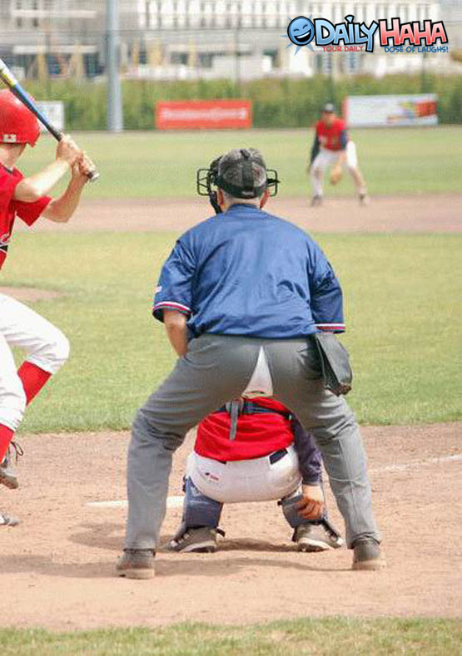
“Propagating Crack”
Notes:
Some researchers favor a “Propagating Crack” model which works like splitting the seat of one’s pants, albeit disturbingly so!

Slide 15
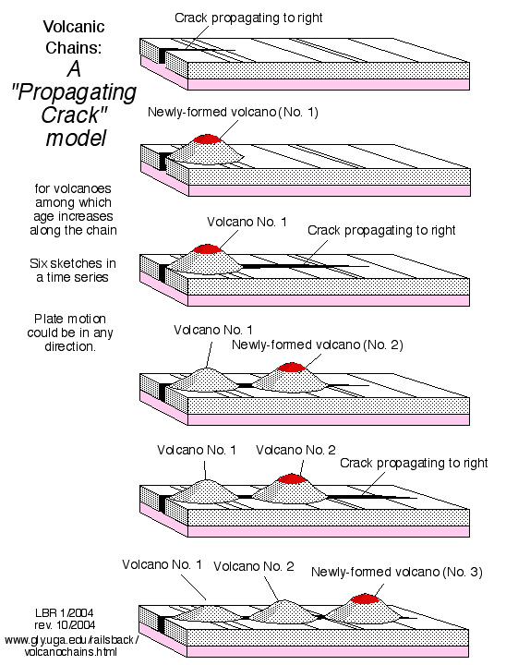
Notes:
Here the well developed volcanic age progression is produced as new volcanoes grow above newly propagated portions of the crack. Old volcanoes die out as their underlying mantle sources become depleted. Such cracks could form in different ways – including the presence of an underlying mantle plume, …

Slide 16
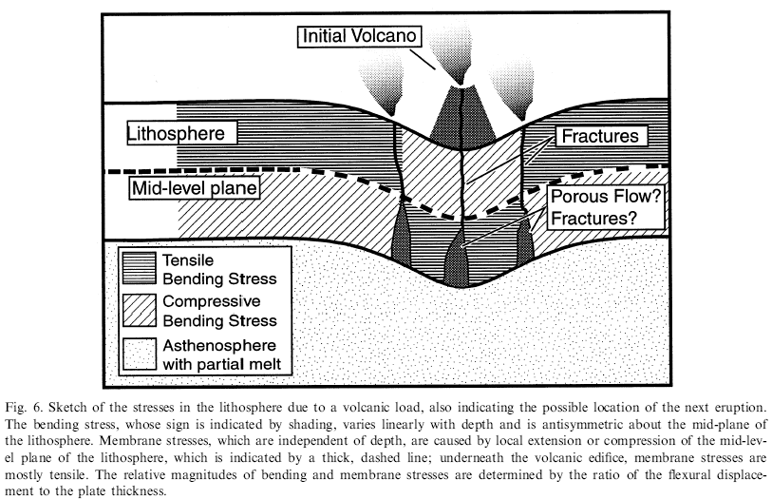
Notes:
…or one of the more intriguing possibilities is that the weight of the volcanoes themselves induces the propagating cracks. As it turns out, Hawaii is not fully explained by any current hypothesis. It is impressive that a region of the Earth so extensively studied for so many years, by so many Earth scientists with so many techniques could remain so intransigent to full understanding.

Slide 17
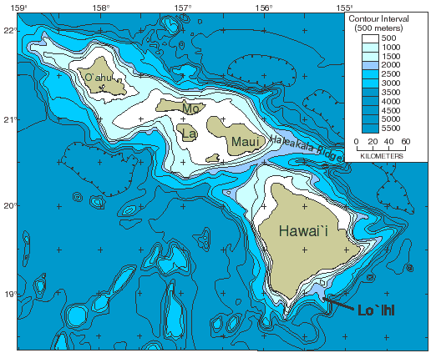
Notes:
Regardless of how hotspot volcanoes form, it is clear that they sink with age. The Island of Hawai`i, known as the Big Island, is built of several volcanoes. The island of Maui comprises two major volcanoes, West Maui and East Maui (Haleakala). But Maui itself is one of four islands that form the once-great island of Maui Nui. The other islands are Kaho`olawe, Lana`i, and Moloka`i. The extent of these islands and the shallow flooded platform that connects them is easily seen in this bathymetric map. Maui Nui probably was similar in extent to today's Big Island. The submergence of Maui Nui resulted from the complex interplay of diminished volcanic upbuilding and continued subsidence as the island complex moved away from the Hawaiian hot spot. A similar fate awaits the Big Island. As the Pacific plate moves relentlessly northwestward, at about 10 cm per year, the Big Island volcanoes will lose their eruptive vigor.

Slide 18
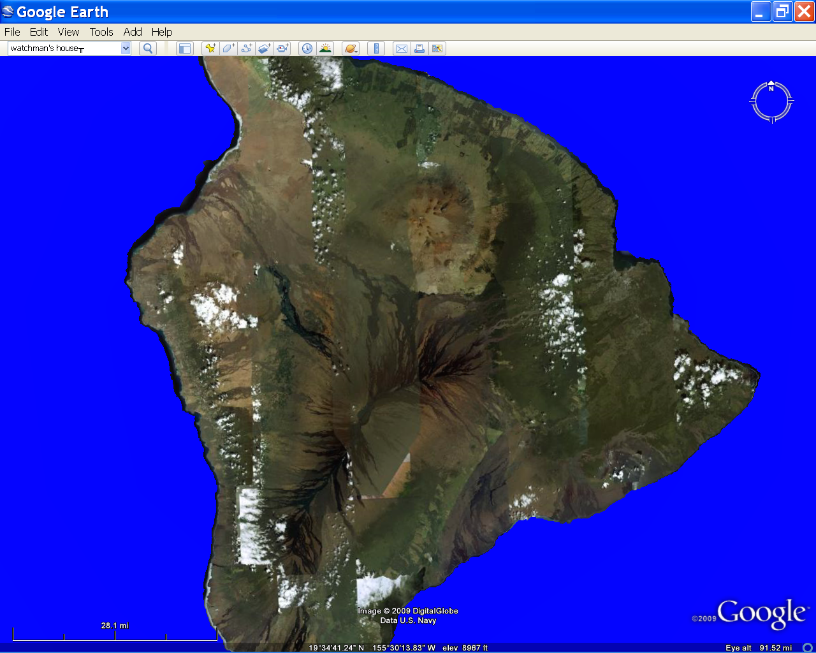
Notes:
Without the benefit of rapid volcanic construction, subsidence will dominate…

Slide 19
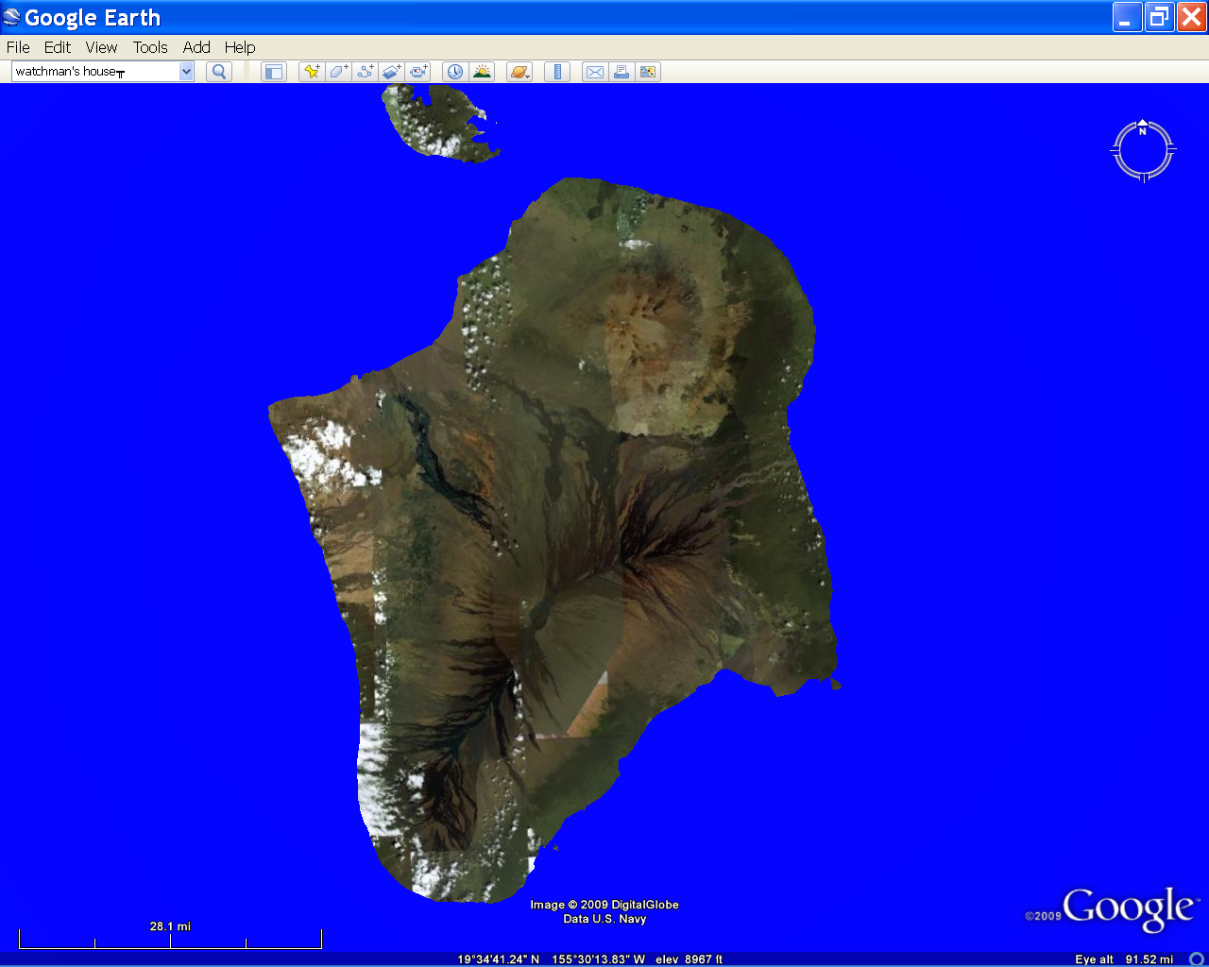
Notes:
… the sea will slowly encroach on the flanks of the separate volcanoes, …

Slide 20
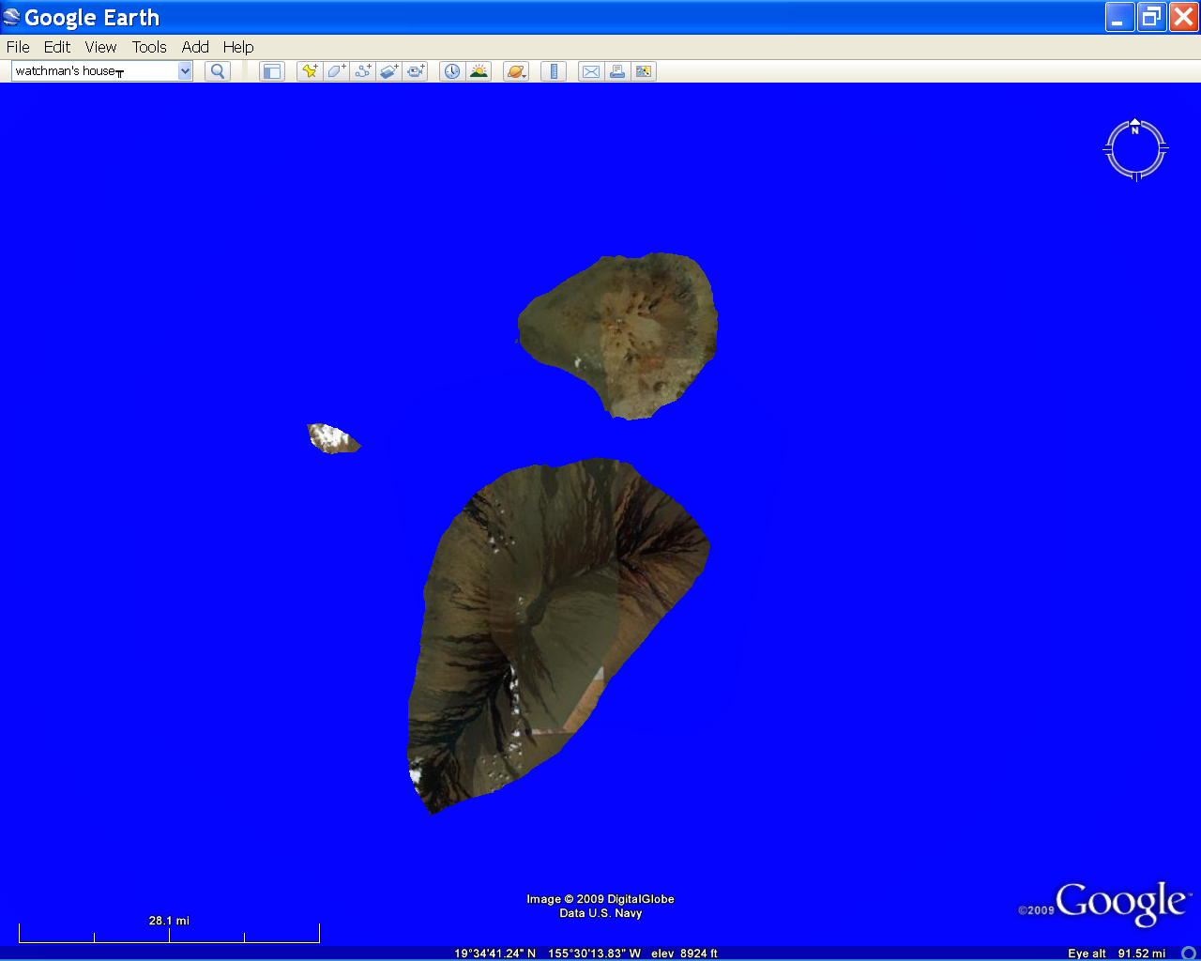
Notes:
… then flood the saddles that separate them, creating smaller islands.

Slide 21
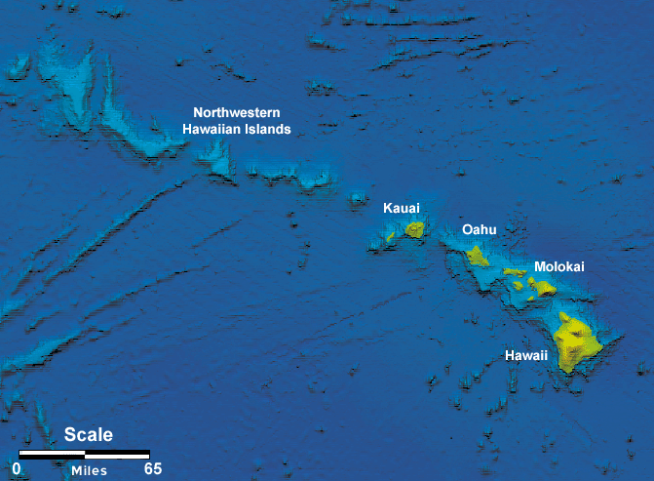
Notes:
The sinking process continues after the islands have become seamounts. Although there are many exceptions, older seamounts are generally deeper.

Slide 22
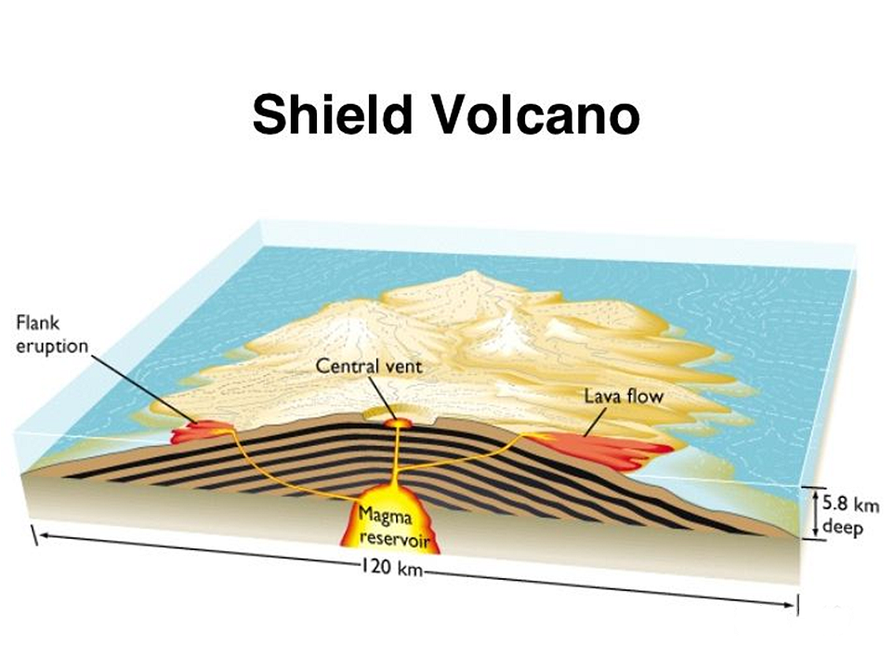
Notes:
All of the large volcanoes formed by hot spot activity are shield volcanoes.

Slide 23
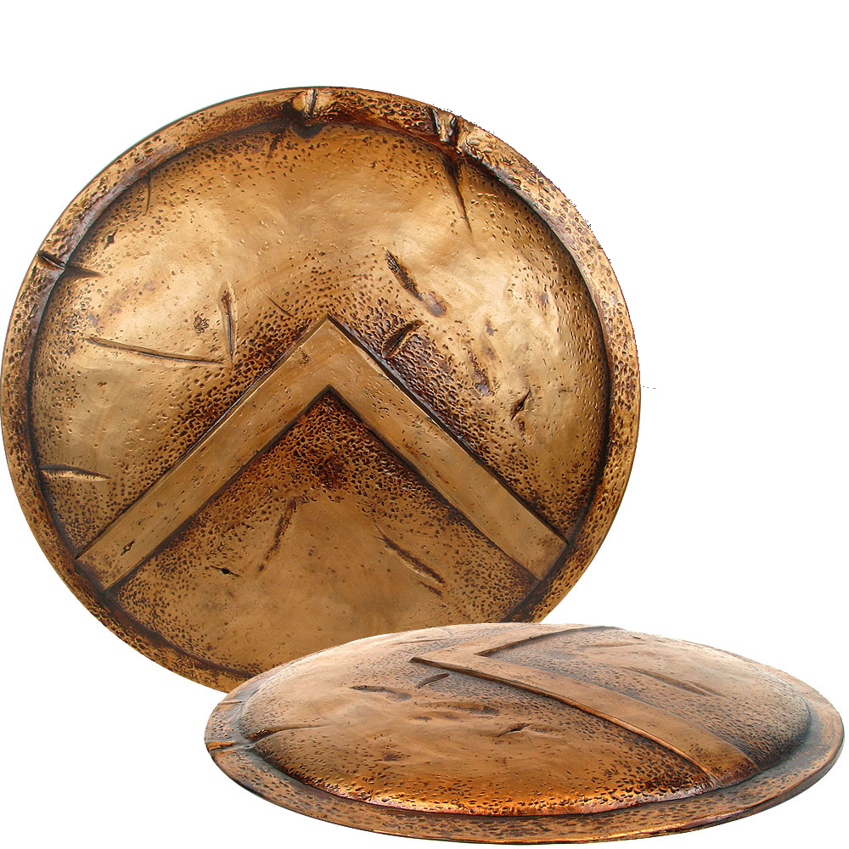
Notes:
The name derives from the volcano’s resemblance to an upturned warrior’s shield.

Slide 24
Notes:
The characteristically gentle slopes of shield volcanoes form because virtually the entire volcano is built from of highly fluid basaltic lava flows which can spread out far from the vent.

Slide 25
Typical Big Island Basalt
Notes:
Although basalt is pretty much the only rock type comprising shield volcanoes, it turns out that the definition of basalt is so broad that geologists recognize several different types of basalt. 99% of the basalt produced at the Hawaiian hot spot is similar to this Big Island specimen.

Slide 26
Tholeiitic Basalt
weathered olivine
Notes:
This is what geologists refer to as tholeiitic basalt. Olivine phenocrysts are common in tholeiitic basalt and speak to its high Fe and Mg content. Here they are weathered into iron oxide.

Slide 27
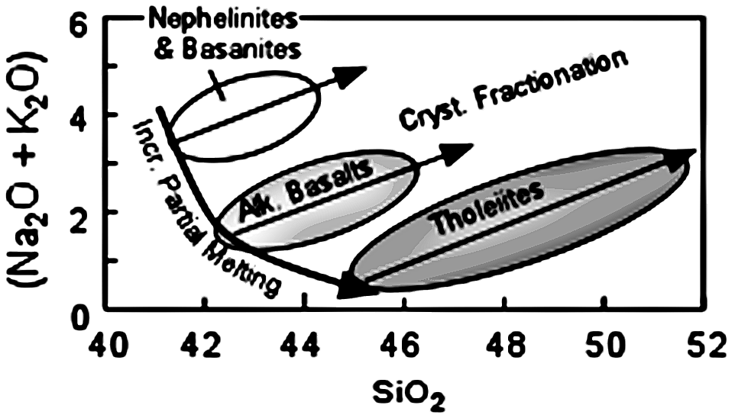
Notes:
Depending on how much crystal fractionation takes place, tholeiitic basalt can contain anywhere from about 45 to 52% silica. The alkali metals, Na and K, increase in tholeiites along with silica as low silica minerals are removed from the melt by crystal fractionation. Tholeiites are formed by relatively large amounts of partial melting of the mantle. If less partial melting of the mantle occurs, then alkali basalt is produced, which may have less silica than tholeiitic basalt, but has more Na and K for comparable silica values.

Slide 28
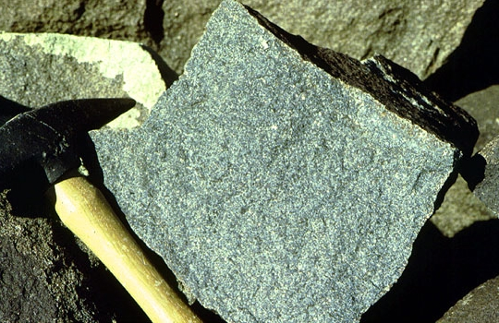
Alkali Basalt
Notes:
Alkali basalt comprises only about 1% of a typical hotspot shield volcano. For years geologists have known that shield volcanoes are capped by alkali basalt during the waning stages of the volcano's eruptive history.

Slide 29
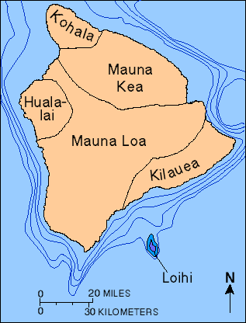
Notes:
But it wasn’t until samples were analyzed of the newly forming, underwater volcano Lo'ihi, just southeast of Hawai’i that scientists became aware that alkali basalt initiates the formation of a shield volcano as well as ends it.

Slide 30
Pre-shield alkalic stage
Notes:
The history of a typical hotspot shield volcano starts with the eruption of alkali basalt as a small percentage of the mantle undergoes partial melting.

Slide 31
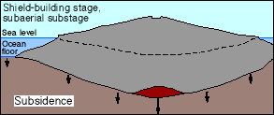
Shield building tholeiitic stage
Pre-shield alkalic stage
Notes:
As hotspot activity increases, so does the proportion of the mantle partially melted, so massive quantities of tholeiitic basalt are produced and vigorous shield building takes place for about 600,000 years. The upgrowth of the volcano is somewhat slowed by the crustal subsidence caused by the weight of the great volcano, but generally the volcano reaches the surface in about 300,000 years. Thereafter shield building continues above sea level for the rest of the volcano’s active period.

Slide 32
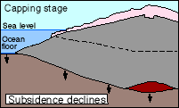
Capping stage
alkalic basalt
Shield building tholeiitic stage
Pre-shield alkalic stage
Notes:
As hotspot activity winds down, less partial melting occurs in the mantle and the shield volcano is capped with alkalic basalt.

Slide 33
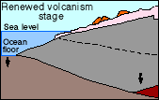
Capping stage
alkalic basalt
Shield building tholeiitic stage
Pre-shield alkalic stage
Notes:
In the final stage, the last remnants of magma escape from the settling volcano producing a short lived period of renewed volcanism. The remaining magma is now highly fractionated and generally gas-rich, and so often produces pyroclastic eruptions that form cinder cones.

Slide 34
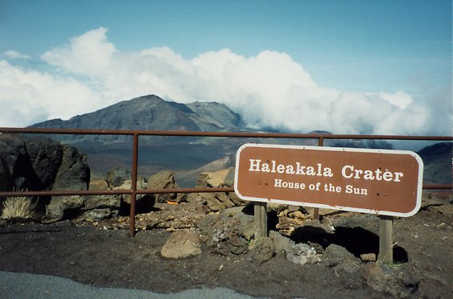
Notes:
Haleakala on Maui is currently in this last phase of volcanism. The view from Haleakala’s rim may not inspire the same time-awe that the Grand Canyon provides, …

Slide 35
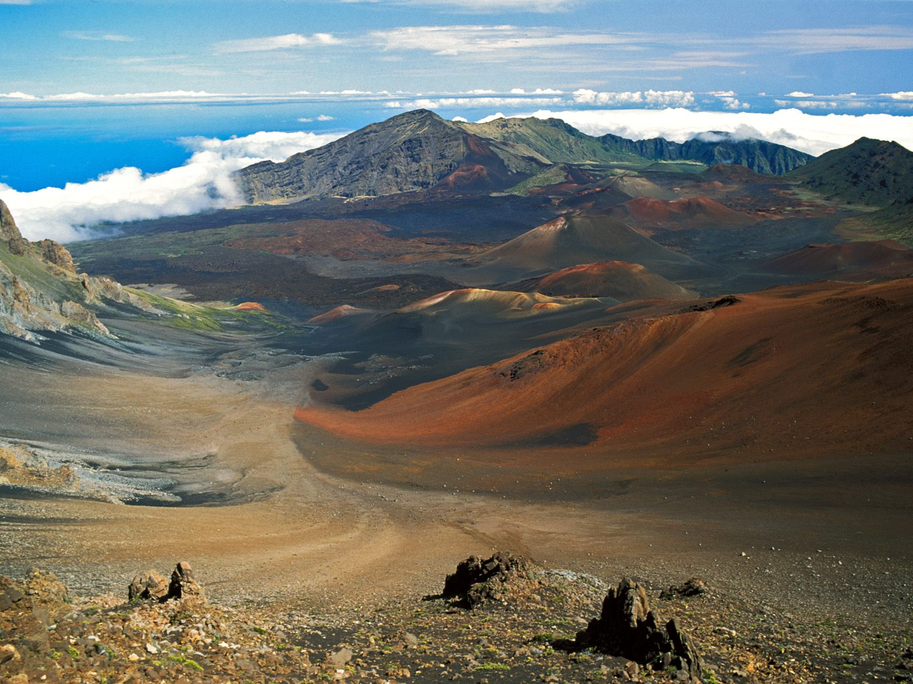
Notes:
… but the sweeping, top-of-the-world perspective of Haleakala’s vast and colorful “crater” is uniquely wonderful. This is not really a crater, but a partially filled erosional feature ….

Slide 36
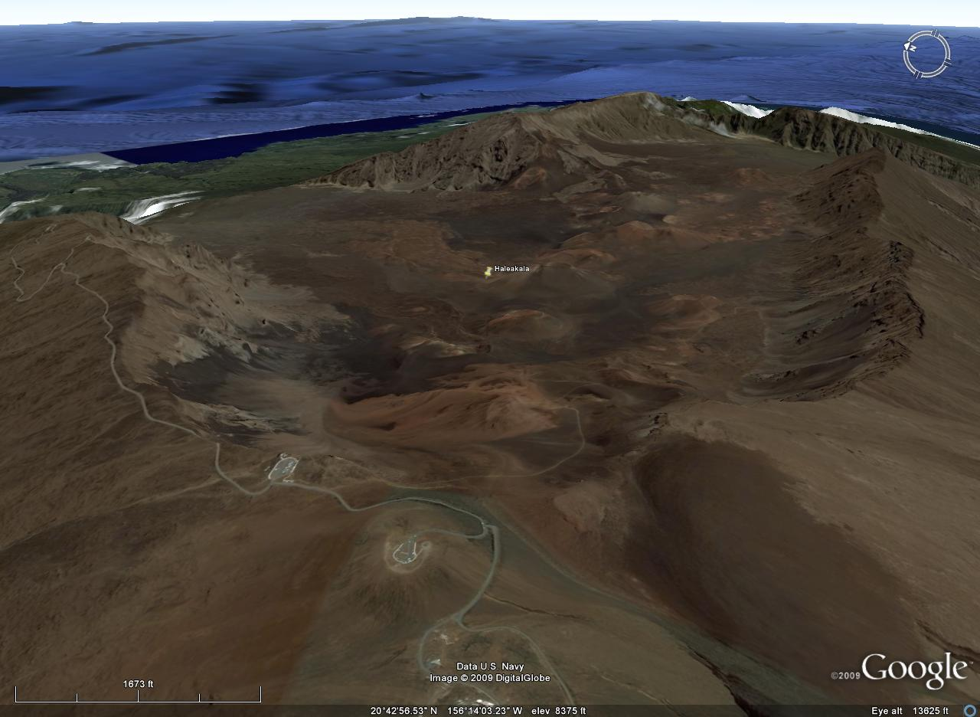
Notes:
… created by the joining of two canyons that deeply eroded two of the volcano’s …

Slide 37
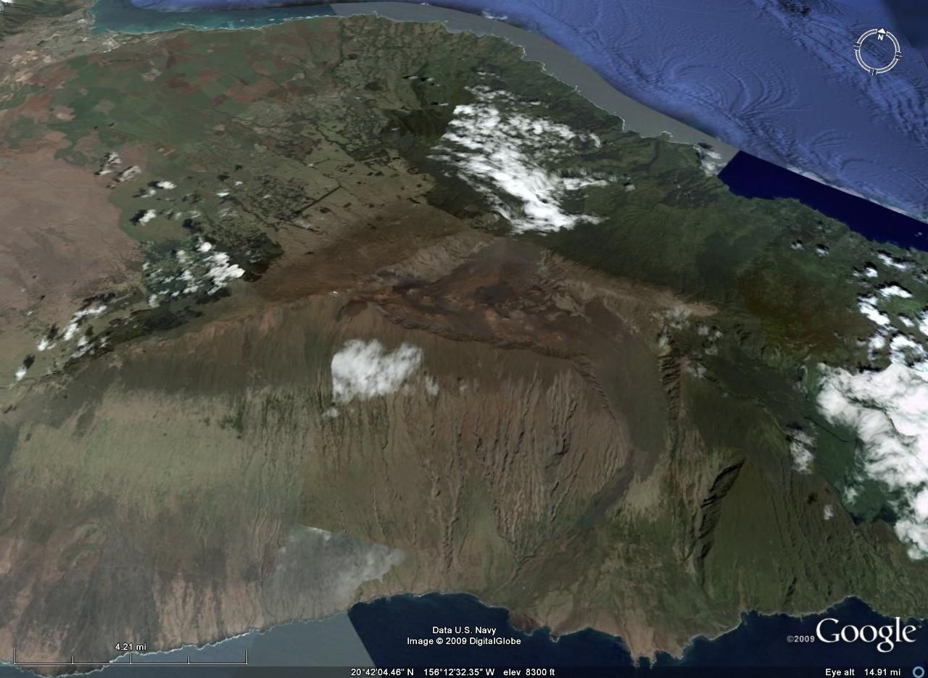
Notes:
… three great rifts that radiate away from its center. Such rifts are essential features of shield volcanoes …

Slide 38
Notes:
… that allow for expansion as the underlying magma chamber is replenished by new magma ….

Slide 39
Notes:
… and contraction when drained by eruptions.

Slide 40
120º
120º
120º
Ideally equally spaced
Notes:
Ideally a shield volcano will have three equally spaced rifts, however the buttressing affects of neighboring shields can greatly influence the spacing.

Slide 41
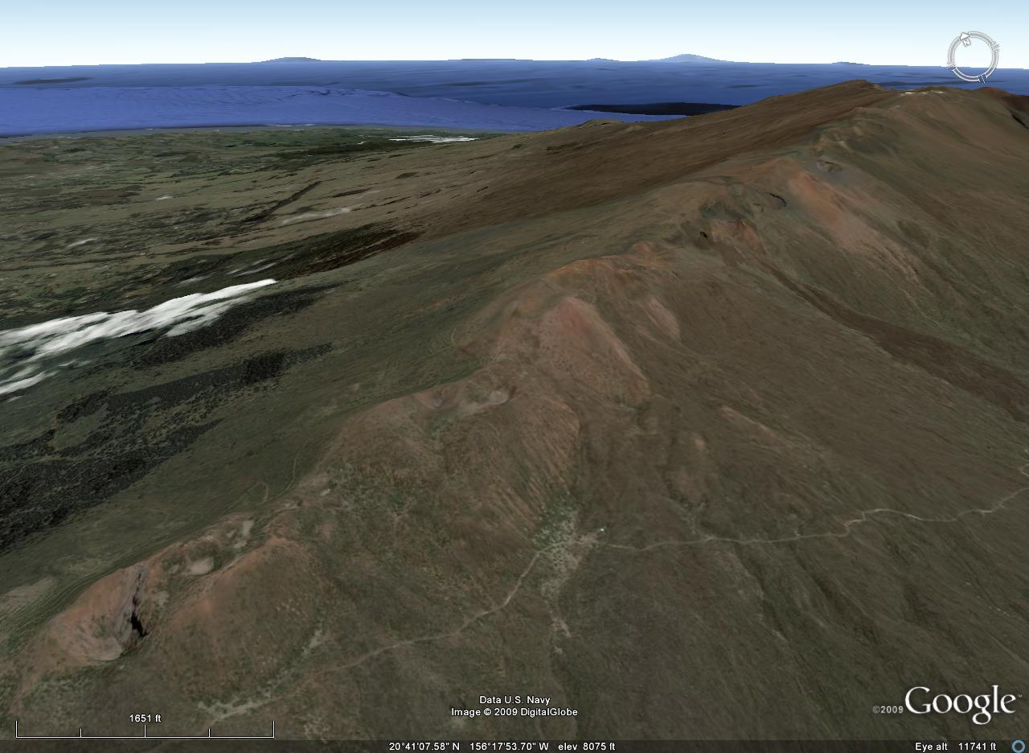
Cinder cones along Haleakala’s western rift
Notes:
Rifts are the primary conduits by which magma reaches the surface of a shield volcano thus most eruptions occur along the rifts. Since Haleakala is in its final stage of eruption, alkalic cinder cones now highlight the trace of the rift, but tremendous quantities of tholeiitic basalt erupted here during the Maui’s shield building period.

Slide 42
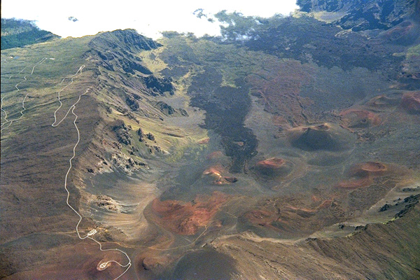
Notes:
Stream erosion along Haleakala’s rifts facilitated the rise of residual, gas-rich, alkalic magma, so numerous cinder cones and flows have partially replaced what erosion has removed.

Slide 43
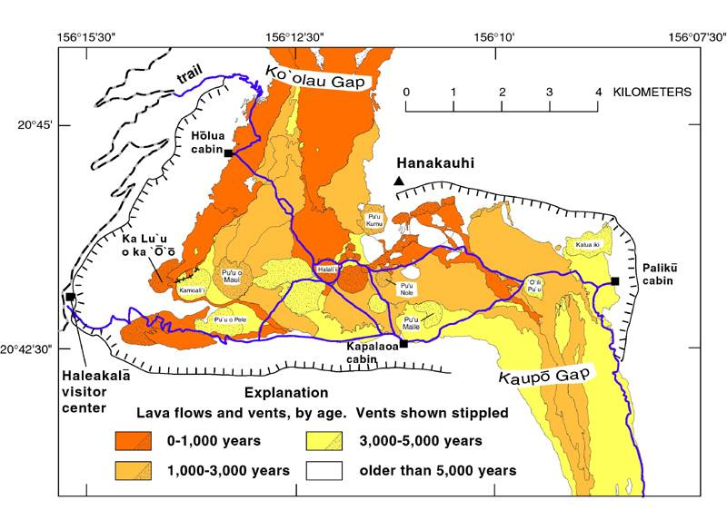
Notes:
Most of these are only a few thousand years old.

Slide 44
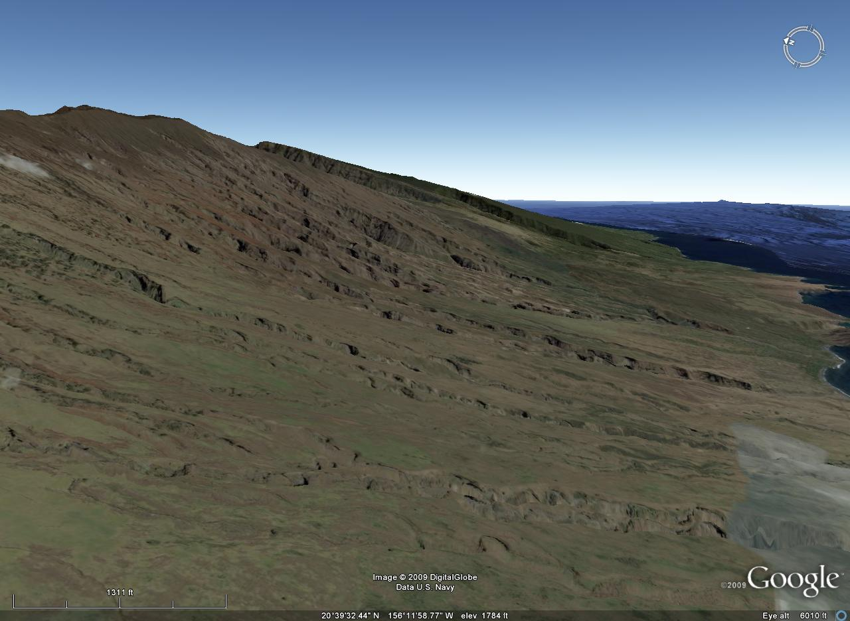
Alkali basalt (14º)
Haleakala’s south slope
Tholeiitic basalt (9º)
Notes:
Since alkali basalt solidifies from more viscous lava than does tholeiitic basalt, the upper slopes of hotspot shield volcanoes are a little steeper than the lower ones.

Slide 45
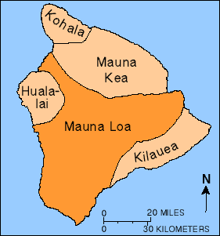
Most Recent Eruption March 24-April 15, 1984
Notes:
The trend to more viscous lava with time is also seen on the island of Hawai’i. Of the five volcanoes that make up the island Kohala is oldest and has been extinct for about 120,000 years. A lot of erosion has taken place during that time …

Slide 46
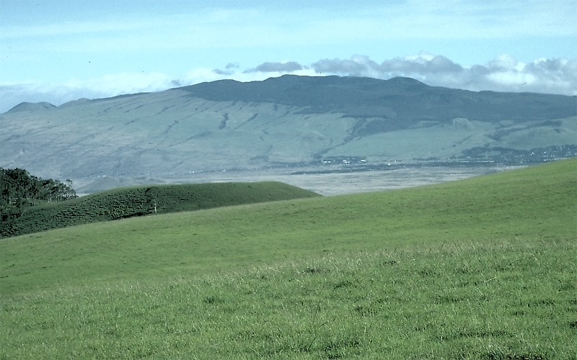
Kohala
Notes:
… so the characteristically steeper slopes of the more viscous alkali basalt lavas are not readily apparent.

Slide 47
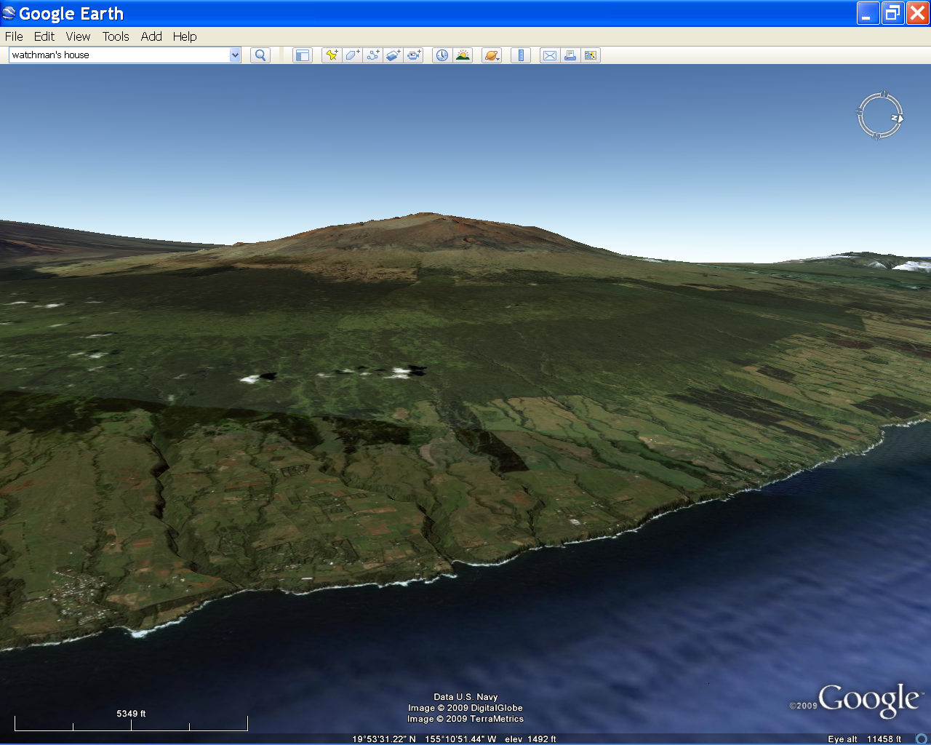
Mauna Kea
Notes:
Mauna Kea on the other hand, the fourth oldest volcano, has not been so eroded …

Slide 48
Mauna Kea
alkalic cap
Notes:
… and the steeper slopes of the alkalic cap are clearly visible.

Slide 49
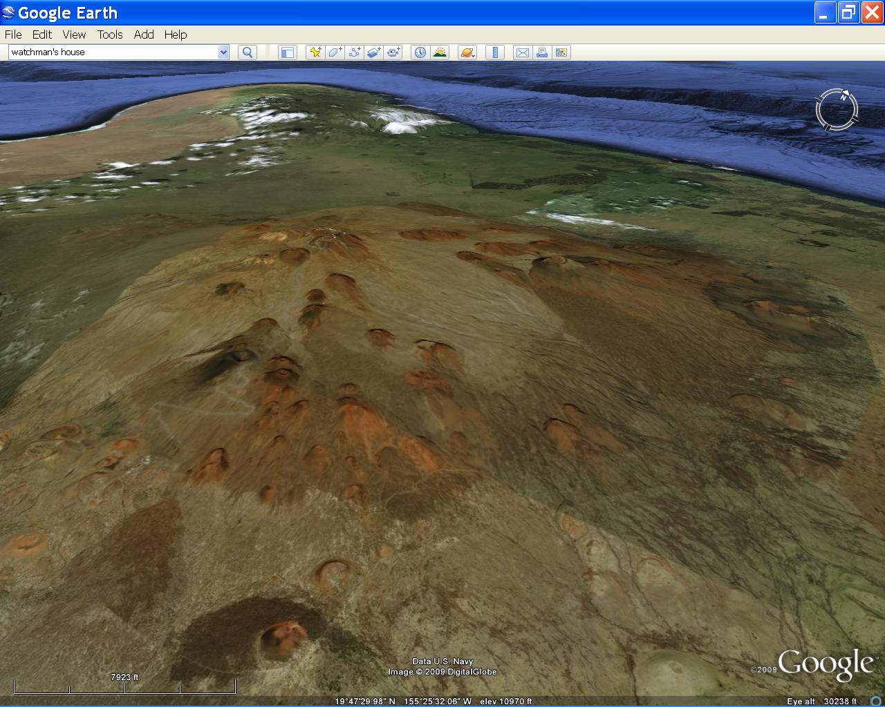
Mauna Kea
Notes:
The dozens of cinder cones that pock mark Mauna Kea’s surface are typical of the post-shield stage of volcanism.

Slide 50
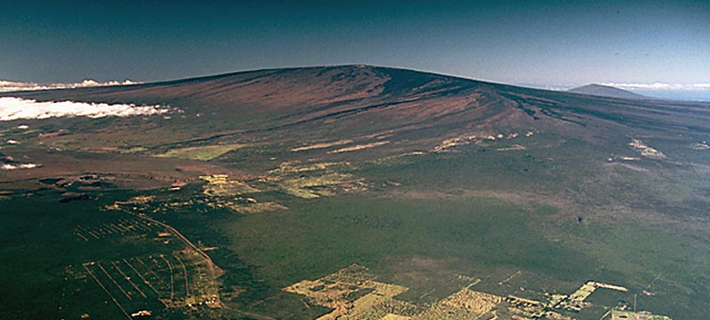
Hualalai
Muana Loa
Kilauea
view
Notes:
Looking west across Hawaii’s three youngest volcanoes the slope progression is beautifully evident. Hualalai is the oldest of these. It has entered the post-shield stage and has the steepest slopes. Mauna Loa has more gentle slopes as it is still in its shield-building stage. However, there are indications that Mauna Loa may be nearing the end of its shield-building phase. The slopes of Kilauea, the youngest and most active volcano, are so gentle as to be almost imperceptible from this angle.

